Slide 1

LAB: Physical Layer
Making your own Ethernet Cable
Md. Fahad Bin Zamal (FBZ)
Senior Lecturer, Department of Software Engineering

Slide 2
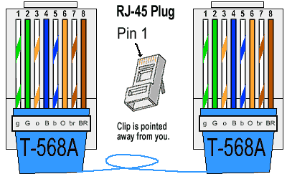

Slide 3
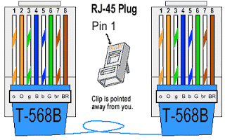

Slide 4
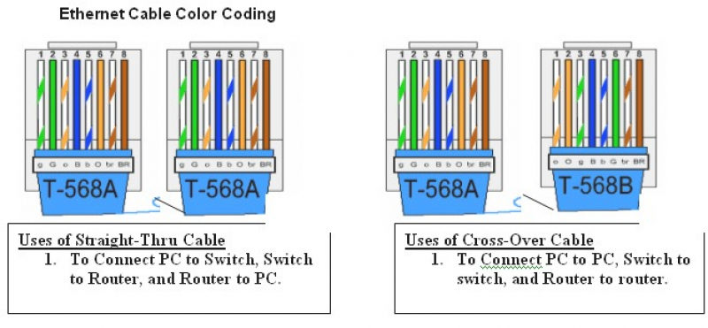

Slide 5
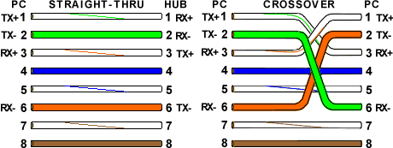

Slide 6
Thank You !!!
Any Questions ???

